Slide 1
Final
Yida

Slide 2
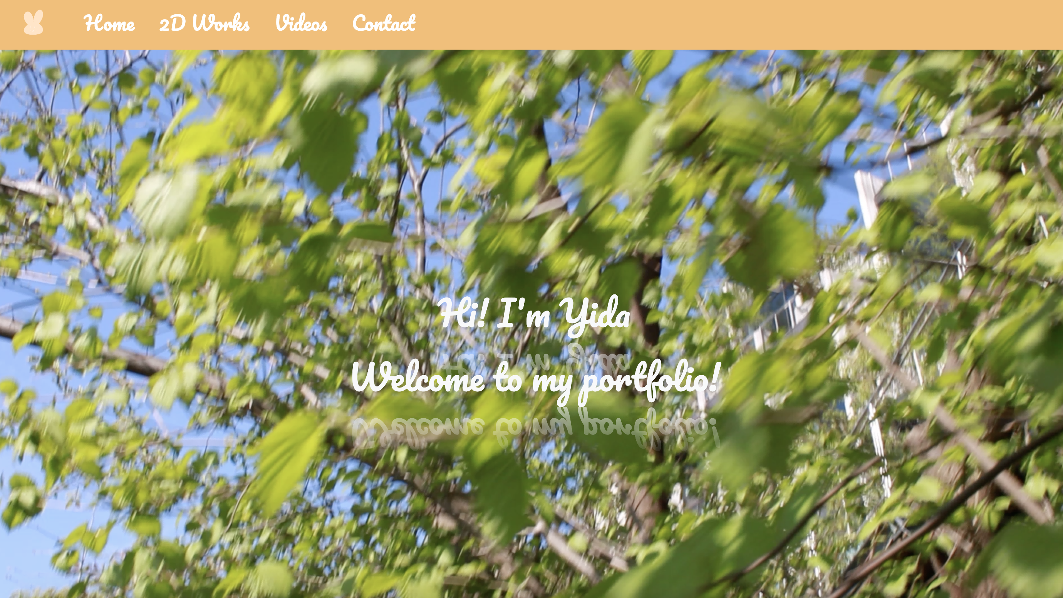
Demo

Slide 3
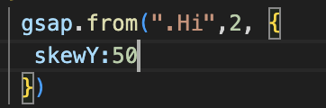
Skew Y

Slide 4
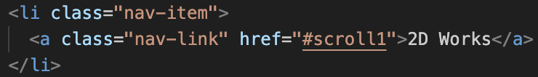
Scroll

Slide 5
animation

Slide 6
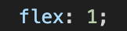
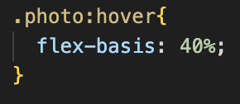
flex,flex-basis

Slide 7

-webkit-box-reflect

Slide 8
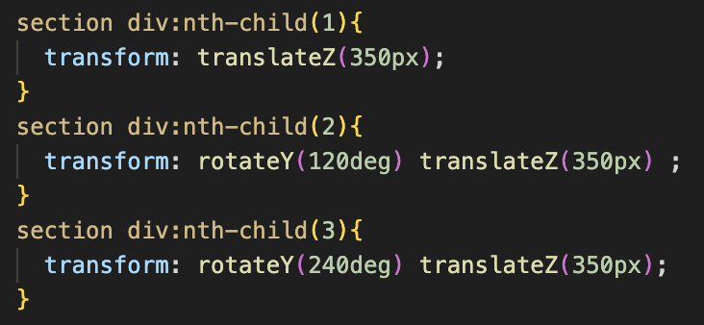
nth-child()

Slide 9
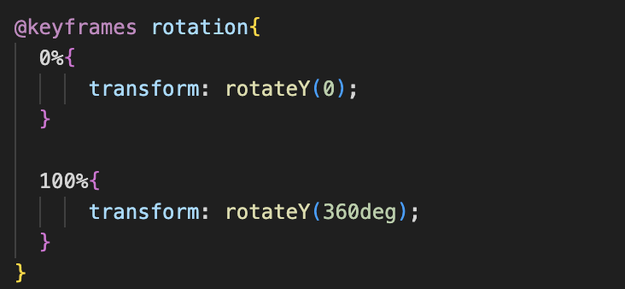
@keyframes

Slide 10

3D

Slide 11
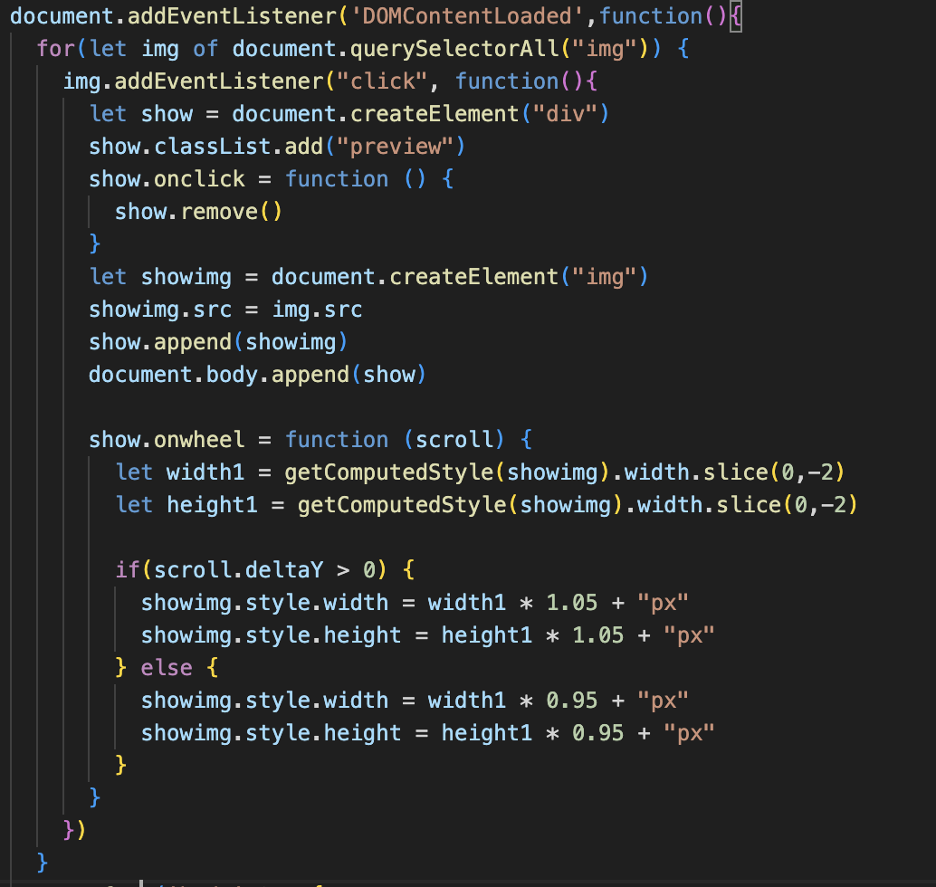
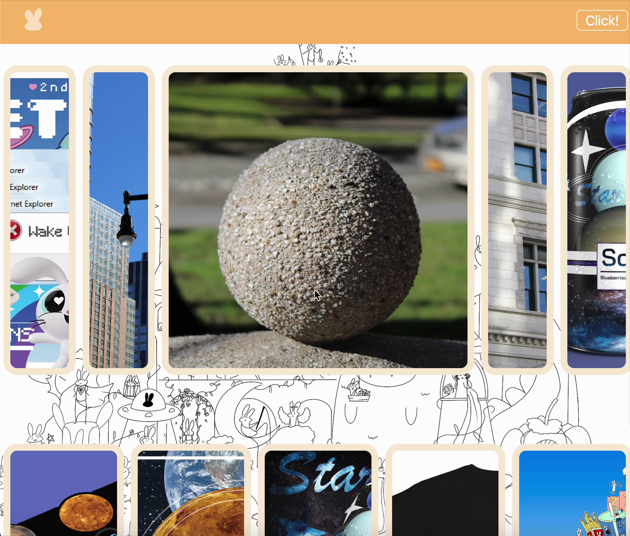

Slide 12
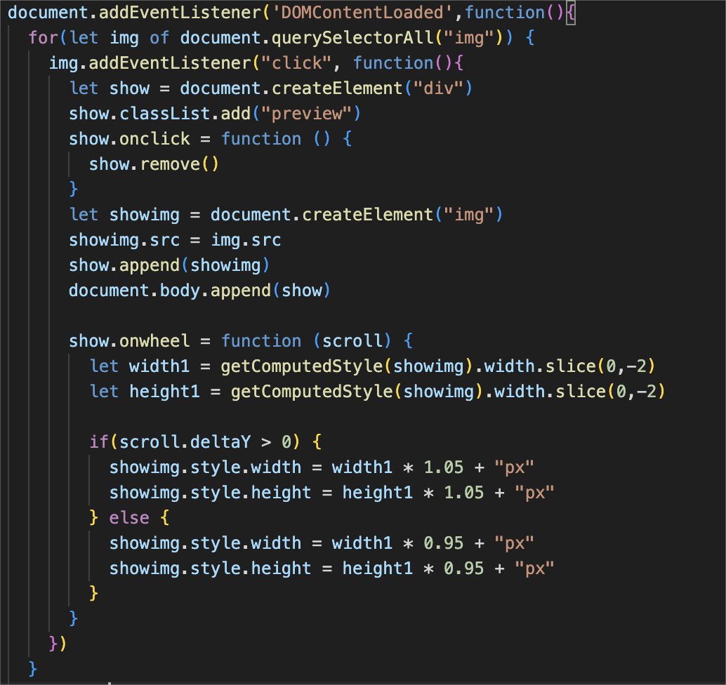

Slide 13
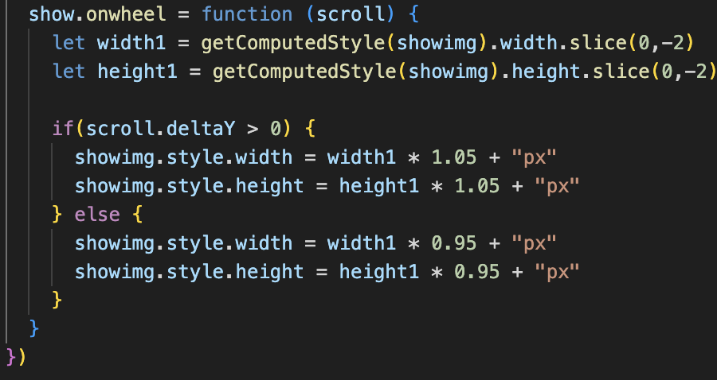
getComputedStyle, onwheel, deltaY

Slide 14
Thank you!

